Slide 1
Traffic impact Briefing

Slide 2
Agenda
Event Overview
Community Outreach Plan
Congestion Mitigation Overview
Daily Impact / Plan

Slide 3
Event
Overview
Test event for the 2015 UCI Road World Championships
May 2-4
400+ collegiate cyclists from 100 universities
Saturday races for 300+ “non-collegiate” cyclists
More than a bike race

Slide 4
Schedule
Friday, May 2 - Team & Individual Time Trial
Saturday, May 3 - Criterium (Collegiate & ProAm)
Sunday, May 4 - Road Race

Slide 8
Pre-phase| Before February 25, 2014
Community Outreach
Ongoing effort to excite, engage and inform regional communities
    Onsite presence at more than 30 events
    Spoke to nearly 100 neighborhood, civic & community groups
    Operated Bike Valet at Folk Festival, Redskins Training Camp and more
    Visibility through ongoing social and traditional media efforts
Direct communications with large organizations and attractions along race route to educate and inform

Slide 9
3 phased Plan
Community Outreach
Engaging Community w/ Details
Direct Dialogue w/ Impacted Businesses & Residents
Traffic Management Plan Outreach & 2nd Wave of Prologues
Ongoing activities across all 3 Phases:
Traditional and social media, event presence, speaking opportunities, neighborhood meetings, etc.

Slide 10
Phase 1 | February 25 – March 18
Community Outreach
Engaging community with route information
    Extensive local media coverage
    Social media buzz
    Direct Emails (leveraging 3rd party lists)
    2015 Hotline & Website resources
    Reverse 911 message to city residents
    Community-wide Prologue events

Slide 11
Phase 2 | March 19 – Early April
Community Outreach
Direct outreach to impacted businesses, organizations and residents
    Door-to-door outreach with leave-behind to businesses
    Direct mail / door-hanger to residents along routes
    Detailed planning with major employers along routes

Slide 12
Phase 3 | April – May, 2
Community Outreach
Announcement of traffic management plan & 2nd wave of community Prologue events
    Announce traffic management plan (road closures & alternatives)
    Media Campaign: paid media, PR, PSA’s, social media, Reverse 911, etc.
    Direct outreach via direct mail and email
    2nd Wave of Prologue events focused on downtown areas

Slide 13
Traffic Mitigation PLan

Slide 14
Congestion Mitigation
A Focus On:
Safety – Event participants, event attendees, citizens, commuters, emergency response, prevention of event related events and incidents.
Efficiency – Effective utilization of transportation grid given limitations imposed by course, identify and correct grid deficiencies prior to event.
Predictability – Clearly define affected area and distribute clear instructions on area access and event footprint. Utilize same planning methods for 2015 for familiarity.
Emergency Response –Specialized emergency response services.

Slide 15
Congestion Mitigation
Coordinated process between partner agencies, businesses and organizers to minimize disruption and maximize potential of event.
  Provide “bridges” into the race island that allows traffic movement
  Real time traffic signal timing adjustments
  Strategic Spectator Experience
      Parking
      Fan areas
  Maximize existing traffic grid via specialized instructions and regulations.
  Communication of detour plans prior to and during event.
    Begins at I95/I295 in north, I64/I295 in east, I95/I295 in south and I64/288 in West.
    Inner Loop

Slide 16
Thursday, May 1
Build-out
Start/finish line buildout
Registration/package pickup
Rider/Team Meetings
Location affected: Broad Street in area of 5th Street
Street Closures: Broad Street between 3rd and 7th Street
5th street between Marshall and Grace
3rd street between Clay and Broad
Closures begin approximately 7 PM

Slide 17
Friday, May 2
Time Trials
Morning: Team Time Trial
Afternoon: Individual Time Trial
Location affected: Downtown, Fan
Street Closures: Time Trial Circuit Course
Special Consideration Areas: 8th and 9th Street/Manchester Bridge, Broad Street and Main Street,14th Street/Mayo Bridge, Interstate Exit ramps VCUMC area Altria Theatre, CenterStage, State Offices, VCU Academic Campus, Downtown Expressway
Street closures and tow routes to begin approximately 3 AM with traffic worked through until 30 minutes prior to start at 9 AM. Full course closure for duration of event with access only occurring at designated locations. Event end time approximate 4:30 PM, road reopening and clearing of personnel expected to take additional 1 hour for full reopen.

Slide 19
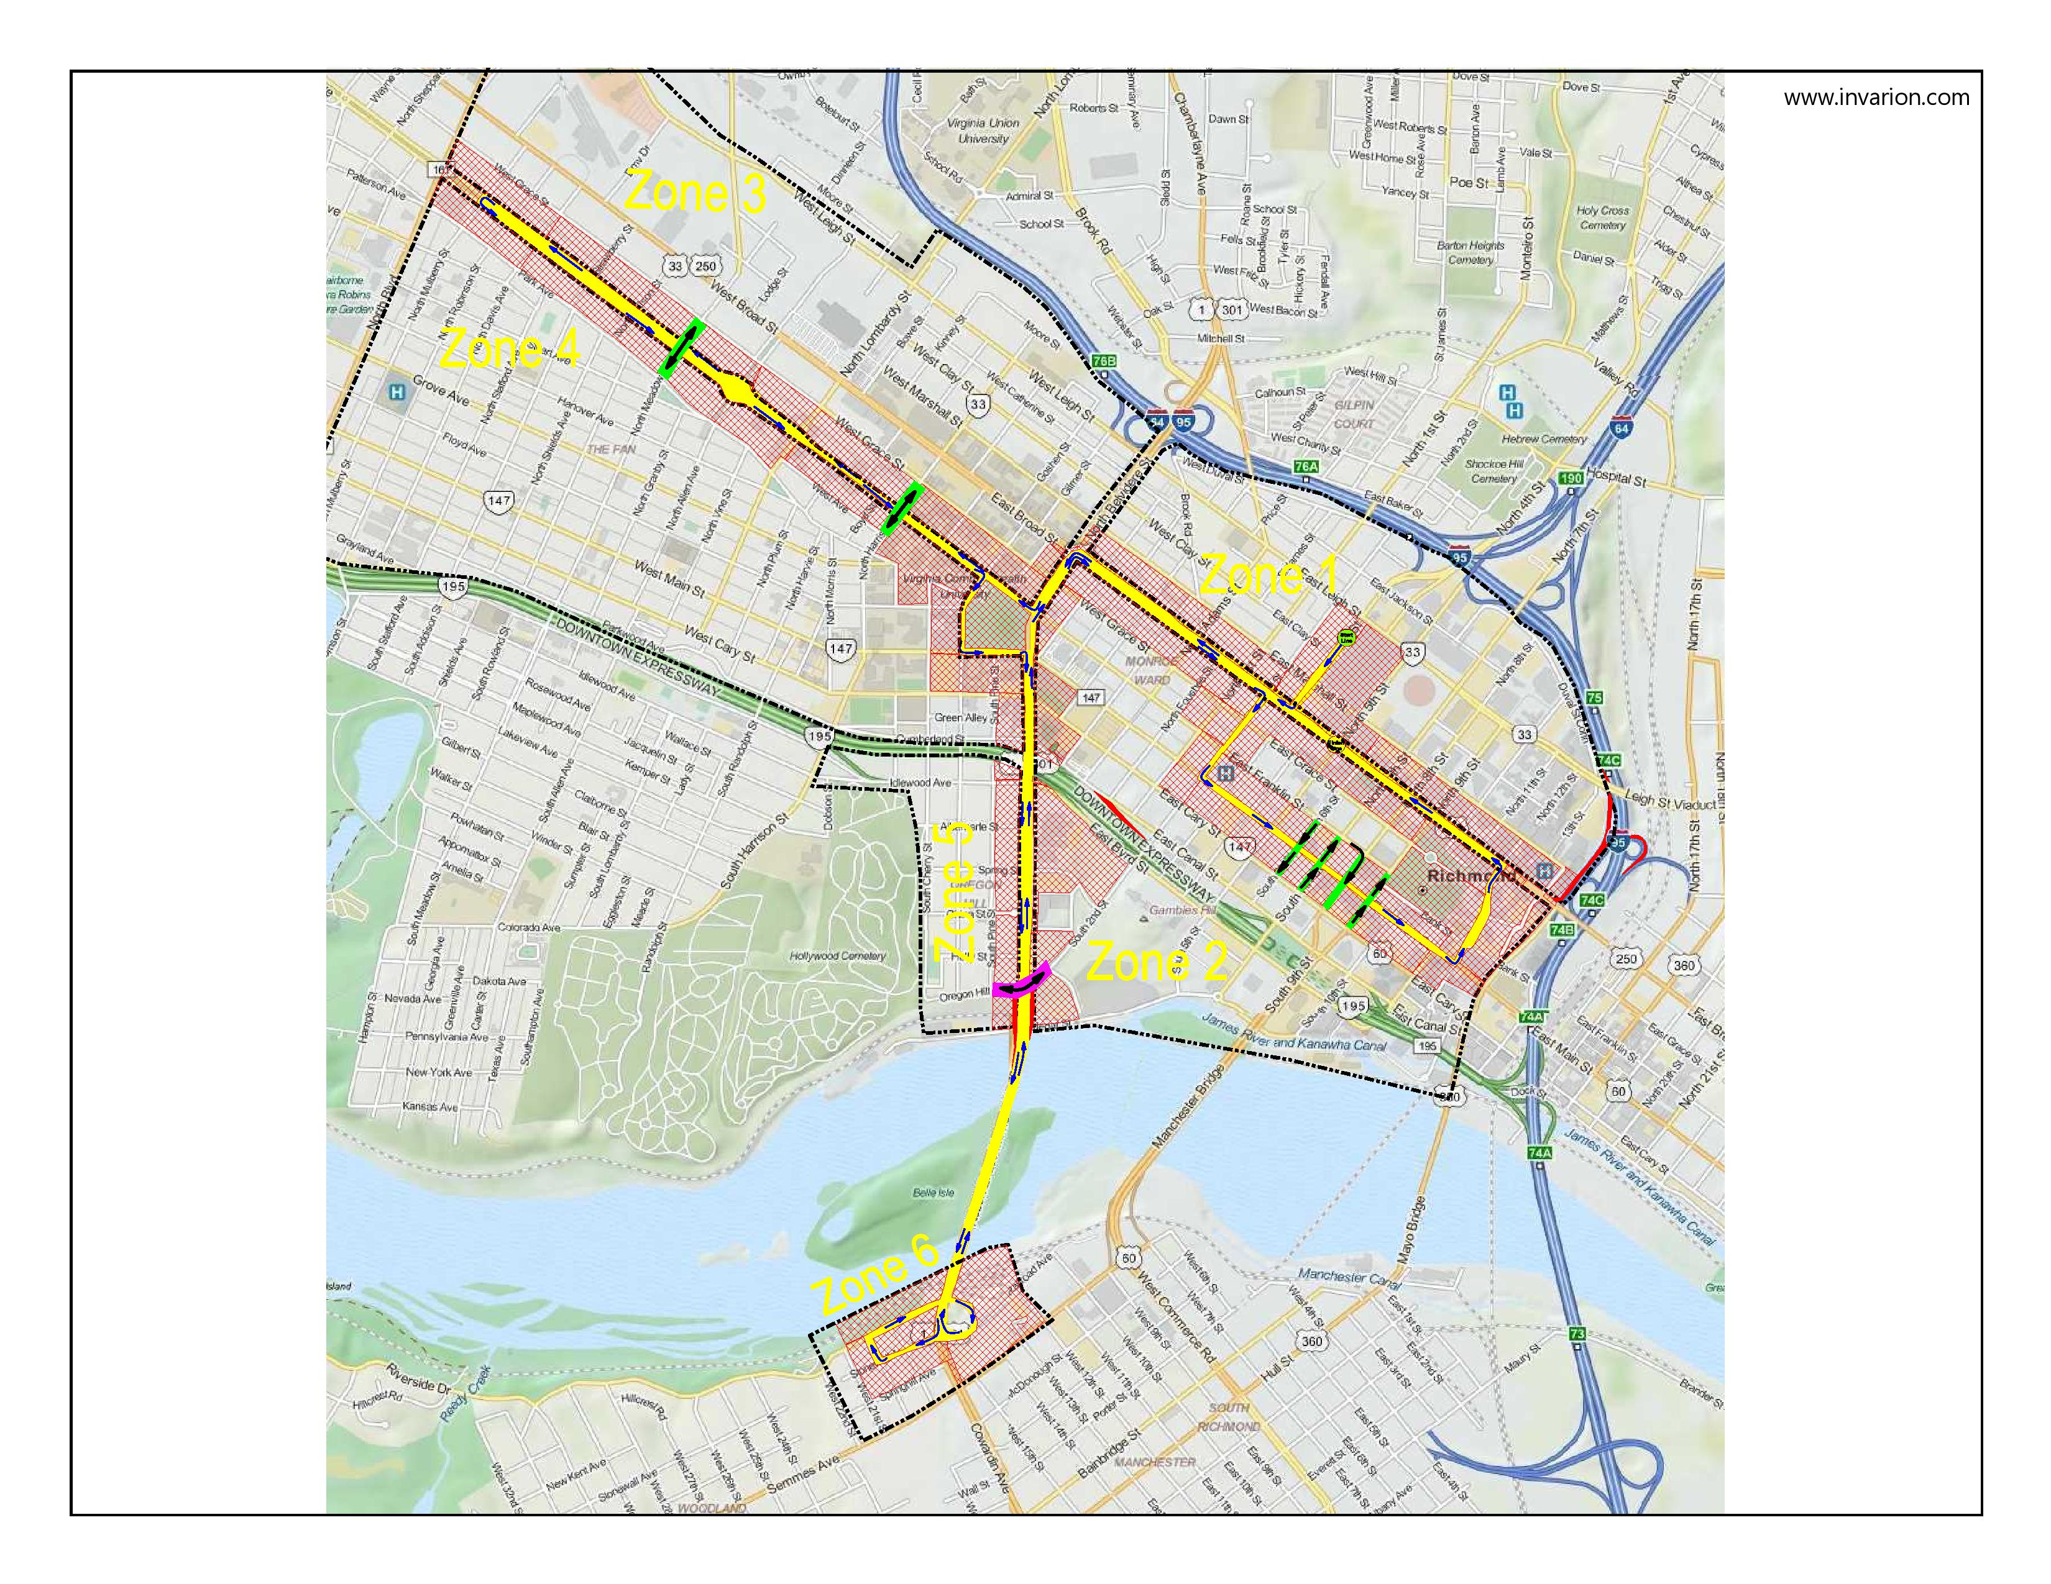

Slide 20
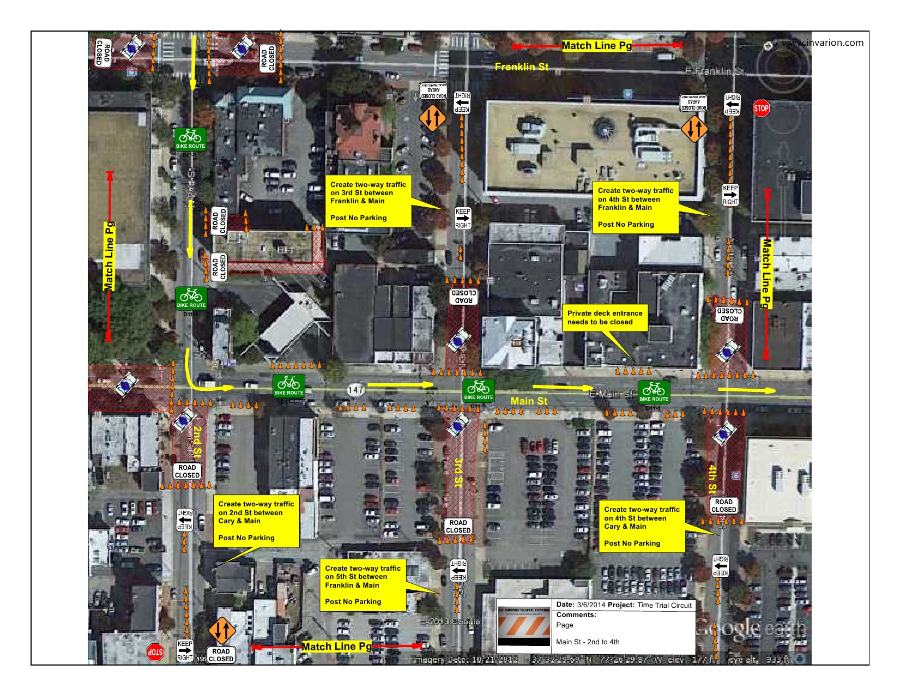

Slide 21
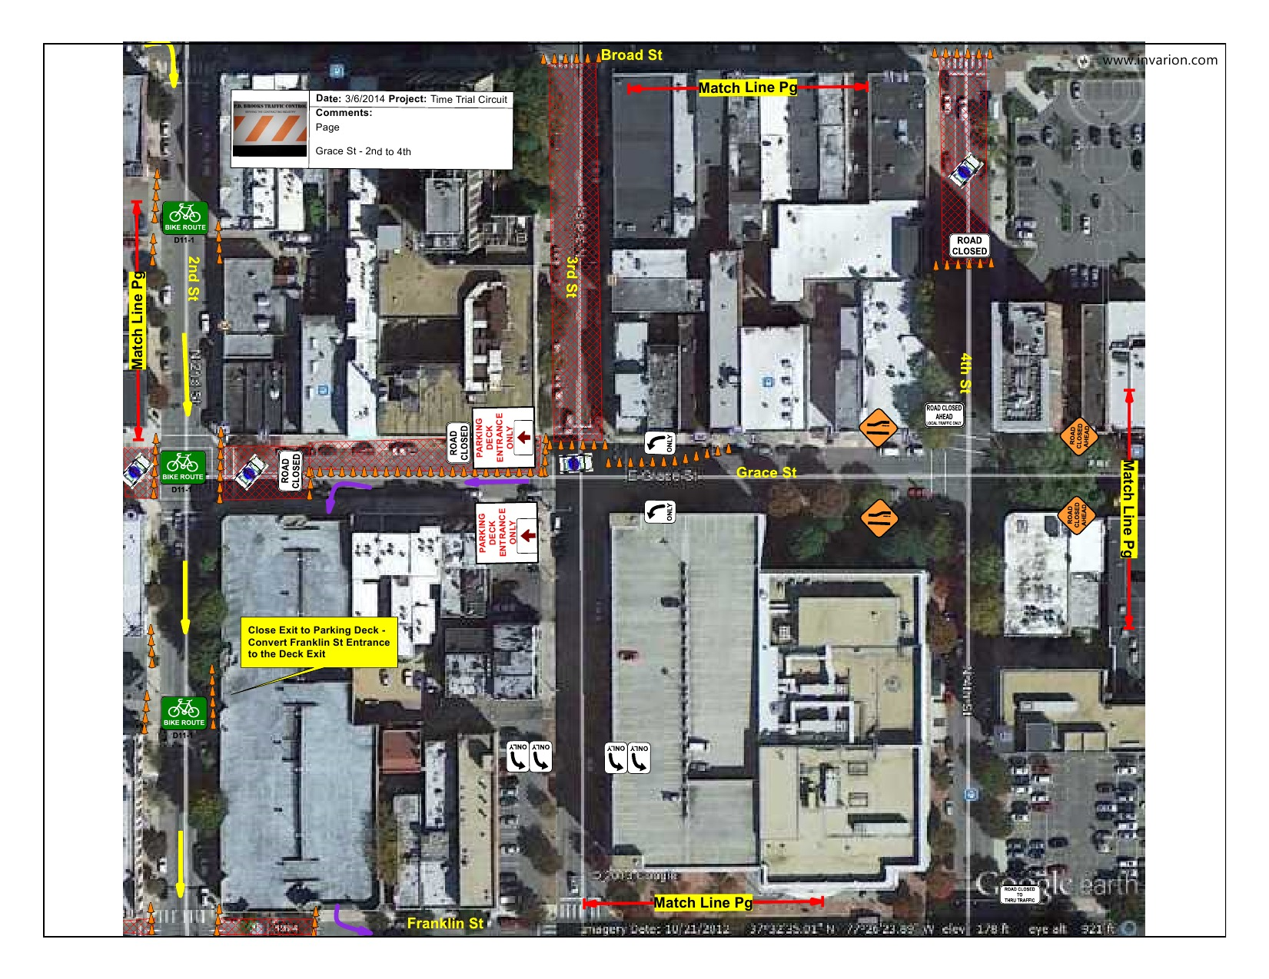

Slide 22
Saturday, May 3
Criterium
Morning/Afternoon: Criterium
Location affected: Business District
Collegiate Criterium Course
      West Boundary 1st Street
      East Boundary 8th Street
      North Boundary Marshall Street
      South Boundary Main Street
In-Bound Access & Out-Bound Access
The Criterium is an island course located in the Business District, there are no major impacts to In-Bound or Out-Bound Arteries. Street closures and tow routes to begin approximately 4 AM with traffic worked through until 30 minutes prior to start at 8 AM and will reopen at approximately 10 PM. Traffic issues are limited to local traffic flow around the course and the interior island portion of the course.

Slide 24
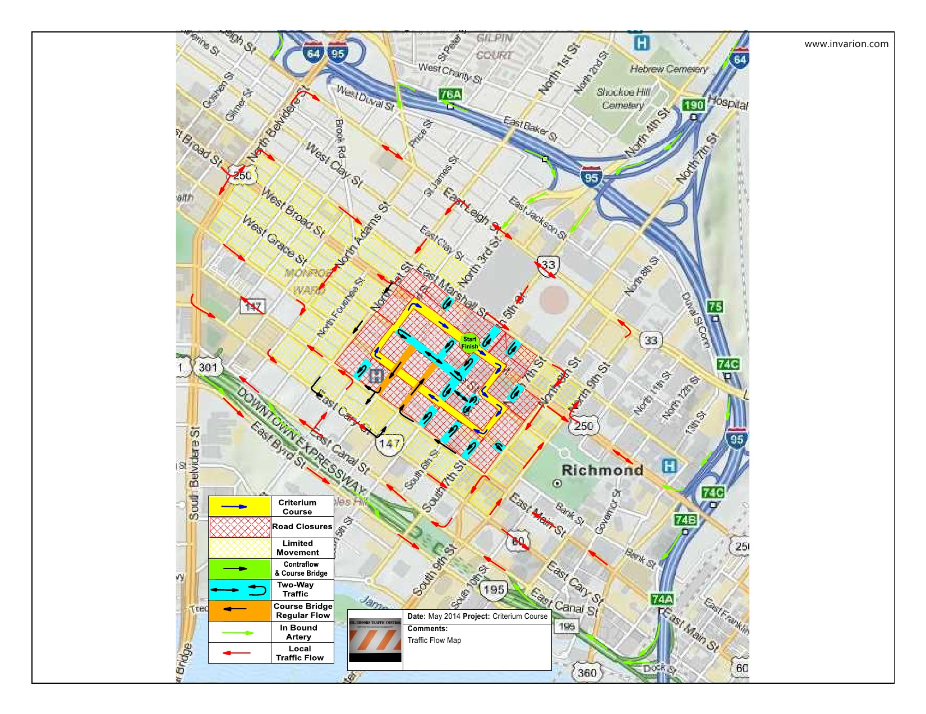

Slide 25
Sunday, May 4
Road Race
Road Race, all divisions
Location Affected: Fan, Downtown, Shockoe Bottom
Street Closures: Richmond Road Race Course
Special Consideration Areas: Federal Courthouse, Libbie Terrace , Dock Street Apartments, Altria Theatre, VCU academic Campus
Street closures and tow routes to begin approximately 2 AM with traffic worked through until 30 minutes prior to start at 7 AM. Full course closure for duration of event with access only occurring at designated locations. Event end time is approximately 6:30 PM, road reopening and clearing of personnel expected to take additional 1.5 hours for full reopen.

Slide 27
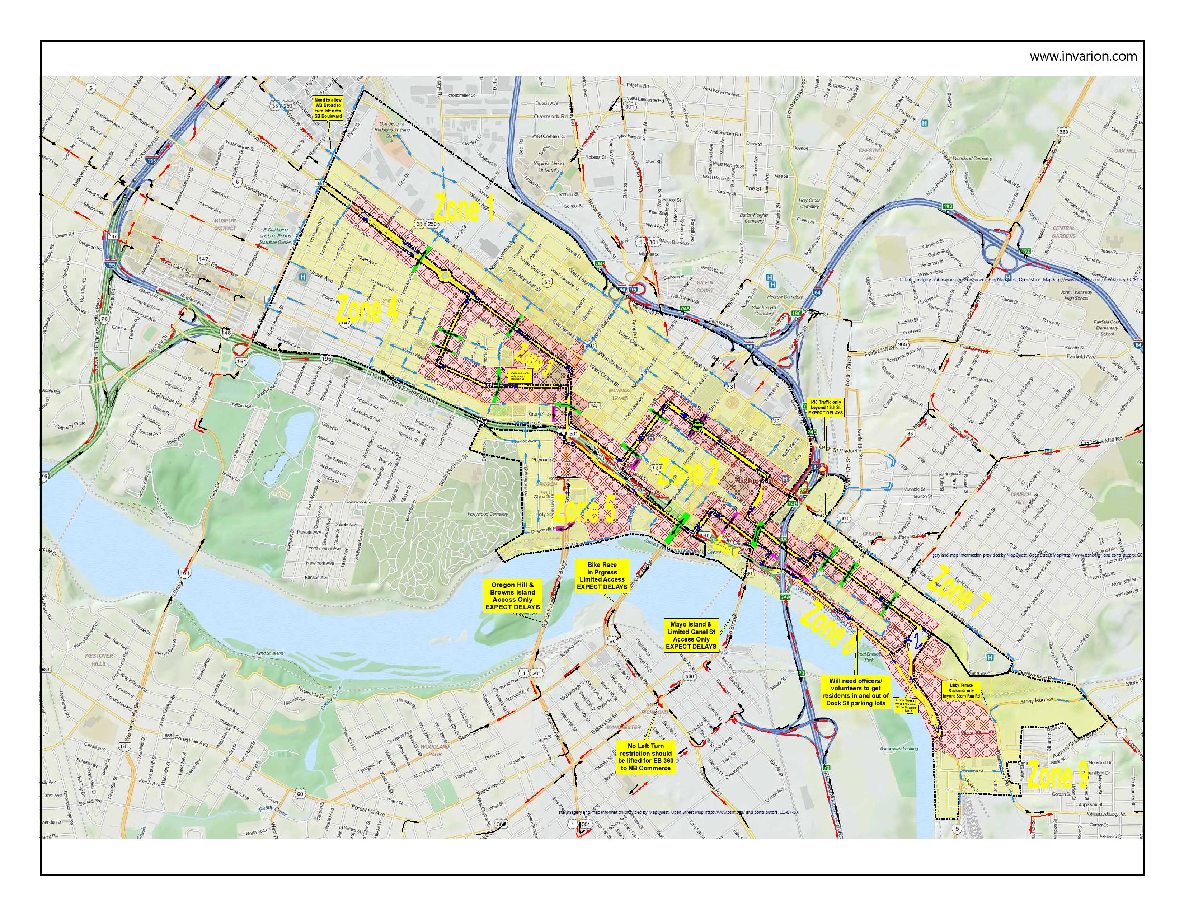

Slide 28
SPECTATOR experiences
Friday, May 2
Prime Viewing Spots:
  Start/Finish at Convention Center
  Monroe Park
  Monument Avenue
Special Events/Attractions:
  Afternoon Block Party (2-6 at Convention Center)
  Annual Collegiate Awards Banquet*
Saturday, May 3
Prime Viewing Spots:
  Start/Finish at Convention Center
  Entire 0.9 Mile Circuit
Special Events/Attractions:
  Family Friendly Expo (All day at Convention Center)
  Course-Side VIP Hospitality (Start/Finish area)*
  *Requires paid ticket, which can be purchased at www.Richmond2015.com

Slide 29
SPECTATOR experiences
Sunday, May 4
Prime Viewing Spots:
  Start/Finish at Convention Center
  Monroe Park
  Monument Avenue
  Libbie Hill
Special Events/Attractions:
  Family Friendly Expo (All day at Convention Center)
  Course-Side VIP Hospitality (Start/Finish area)*
  *Requires paid ticket, which can be purchased at www.Richmond2015.com

Slide 30
Upcoming Prologue Events
Need details
For More information please visit:
Need details

